Slide 1
Customer Retention

Slide 2
What is Customer Retention
Customer retention refers to the activities and actions companies and organizations take to reduce the number of customer defections. The goal of customer retention programs is to help companies retain as many customers as possible, often through customer loyalty and brand loyalty initiatives. It is important to remember that customer retention begins with the first contact a customer has with a company and continues throughout the entire lifetime of the relationship.
The next few slides contain observations from collected from the Indian online shoppers. Results indicate the e-retail success factors, which are very much critical for customer satisfaction.
Let us go through few factors which help in determining the success behind an Online Platform

Slide 3
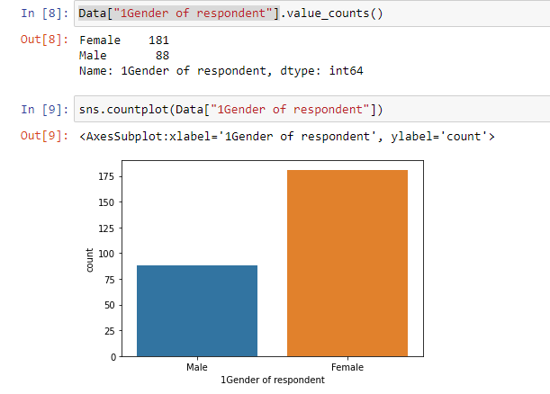
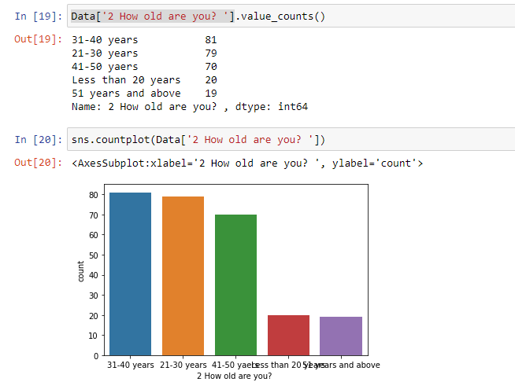
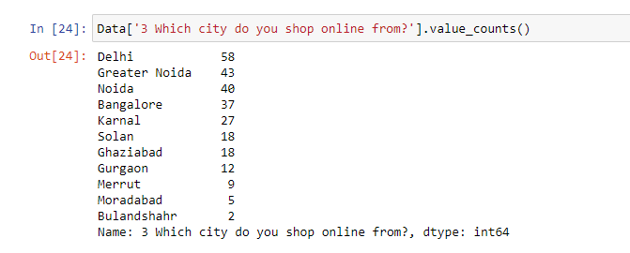
Required Libraries:
Loading the dataset: 1st Observation:
Majority of the online shopping is done by females and the age group is between 21 to 40 from Delhi, Noida and Greater Noida region. This is the range of the target audience who mainly involve in Online Shopping.

Slide 4
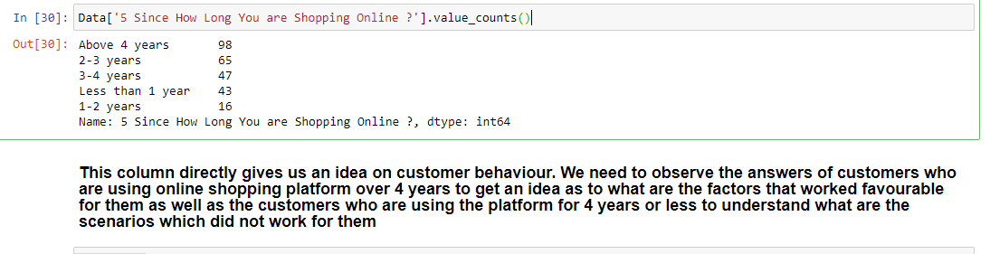
Target Variable
The main target variable which helped us to understand whether a particular customer has been retained or churned. The below data shows us how long a customer has been retained and in the later part of the dataset all comparisons have been done keeping this in mind. For the betterment, I have transformed the below years into numbers.

Slide 5
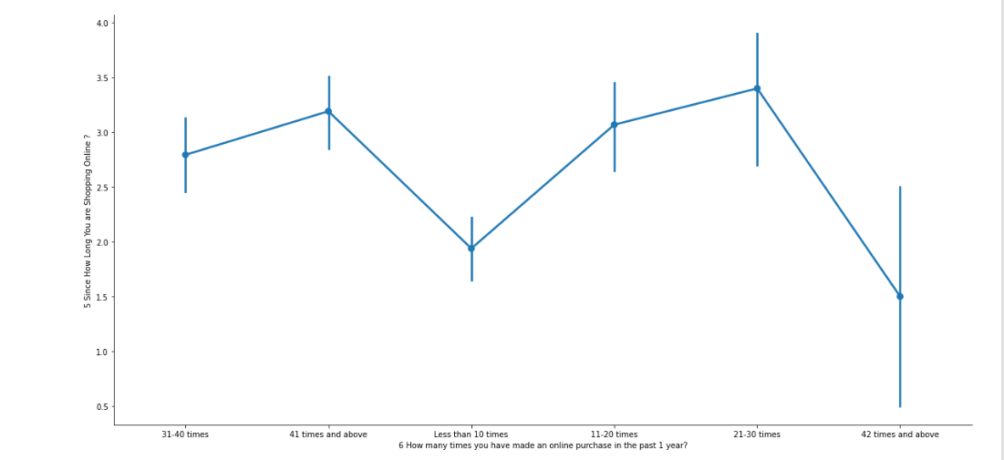
Number of times a customer made online purchase last year

Slide 6
Observation
From the data in the previous page it is observed that customers who have been retained visited the platform maximum around 31 times however maximum visits of 42 times and above have been given by those who are maximum 2-2.5 years old. Therefore visiting a page numerous time will not give an idea whether the customer can be retained.

Slide 7
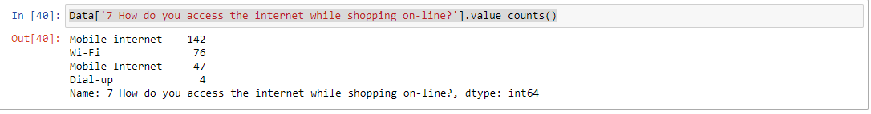
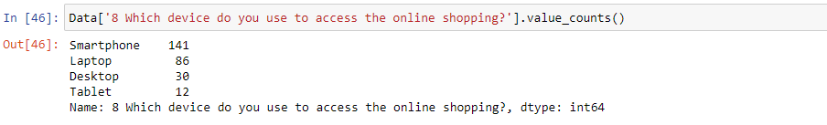
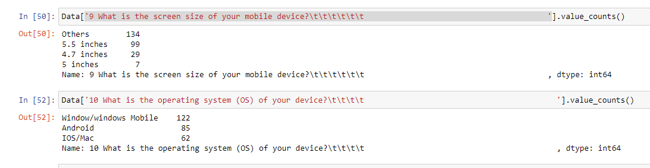
Internet Connection,Device Used and Operating System

Slide 8
Observation
Majority of the customers use Wifi and mobile internet on their smart phone and laptop with a normal screen size from their windows/android device. Therefore all the sites should be made in such a way which is compatible with the user’s device by not slowing it down or by using huge internet.

Slide 9
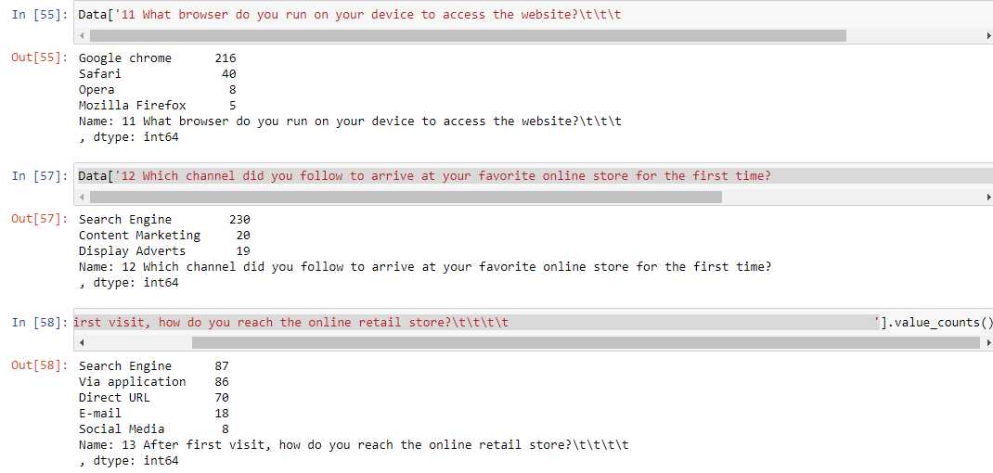
Online Sites

Slide 10
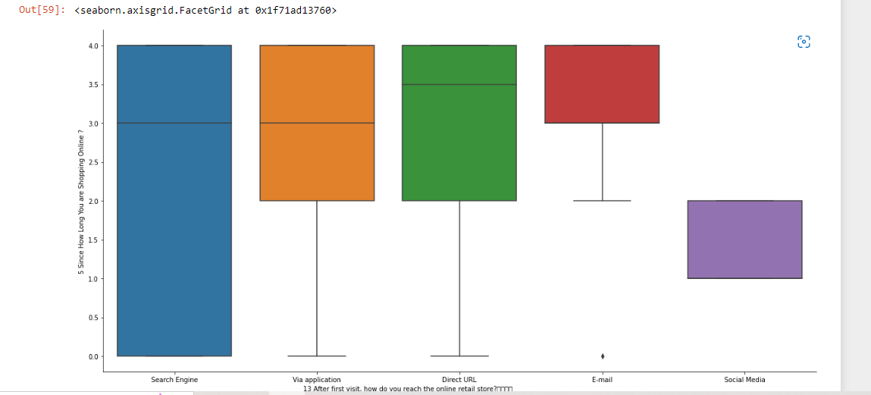
Observation
Majority of the customers are able to know about an online platform from their search engines ( mainly Chrome) and interestingly social media platform have taken a backseat here when it comes to retaining a customer for a long time.

Slide 11
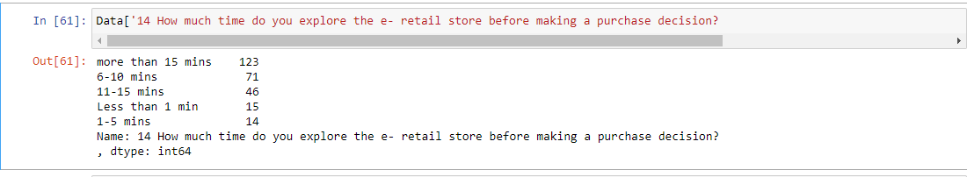
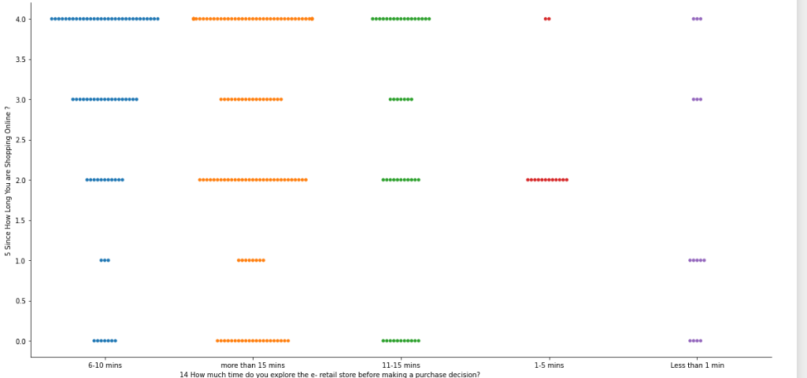
Time Taken: Majority of the customers spend minimum 15 mins behind every choice

Slide 12
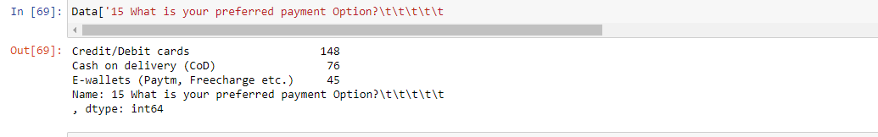
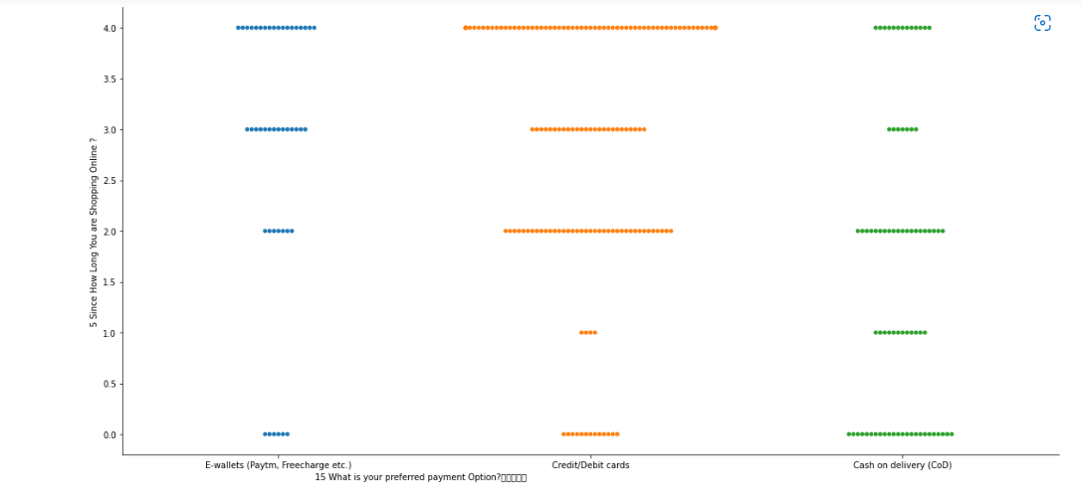
Mode of Payment: Customers who are retained usually go for Debit/Card transaction whereas majority of the customers between the period of 1-2 years go for Cash on Delivery (COD).

Slide 13
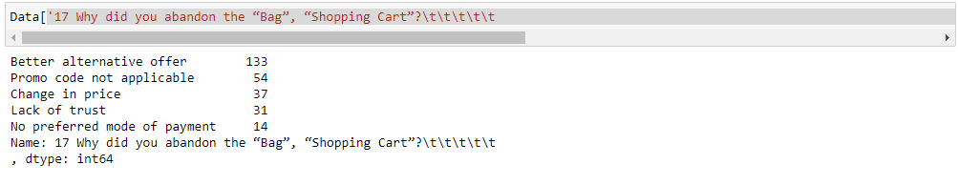
Frequency of Abandoning the cart
Data has been replaced in the following mode: 'Sometimes':0,'Never':1,'Frequently':2,'Very frequently’:3
Reasons for abandoning:
The common reason for customer abandoning the cart is they have received better alternate offer. In the next slide we will see what made the customer abandon the cart frequently/sometimes/never/very frequently

Slide 14
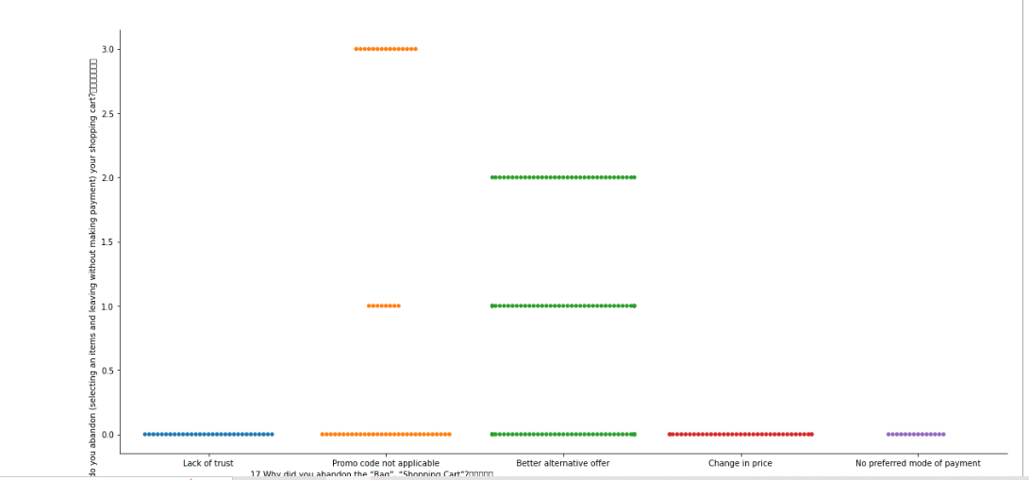
Reasons for abandoning: Best Alternate Offer and Promo Code Not Applicable

Slide 15
Customer Remarks and Opinions

Slide 16
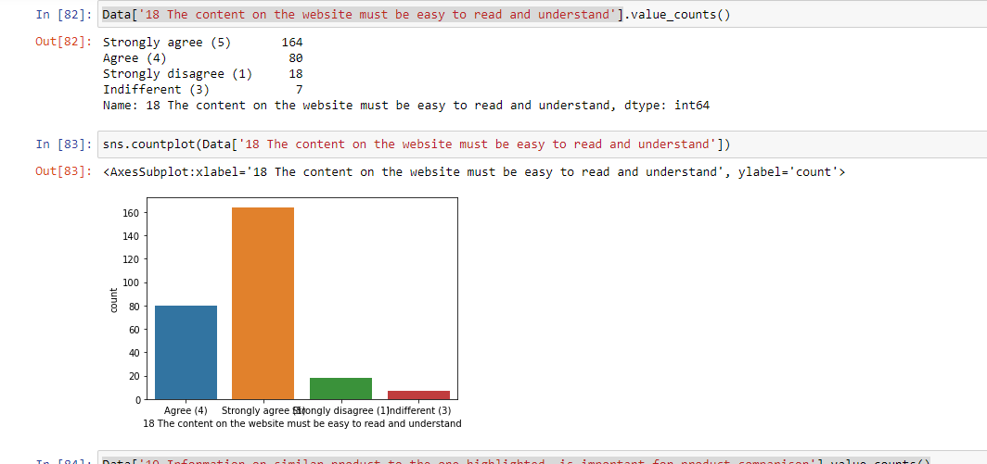
Content must be easy to write and understand

Slide 17
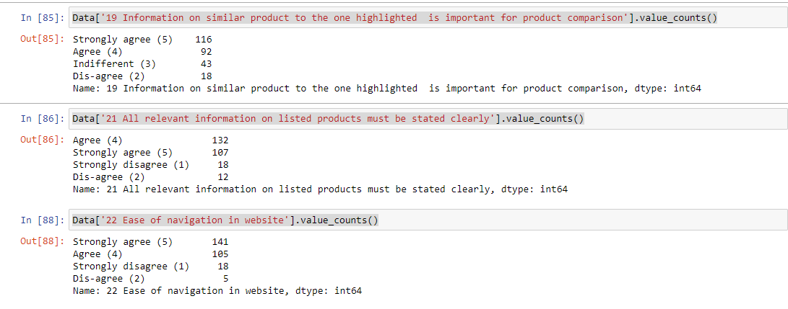
Similar Product Information for comparison is important
All relevant information should be listed.
Ease of navigation in Website

Slide 18
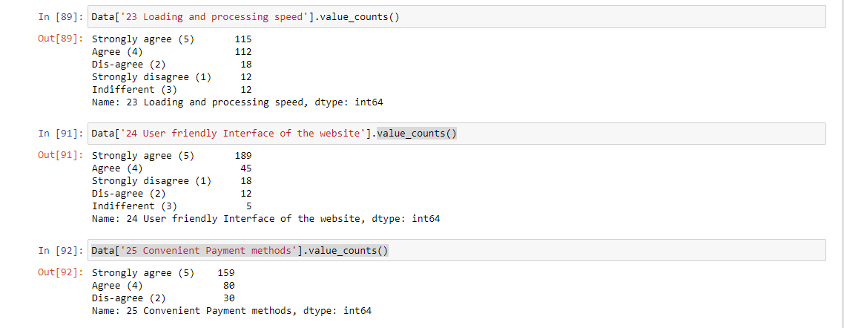
Speed in Loading and Processing.
User Friendly Interface.
Convinient Payment methods

Slide 19
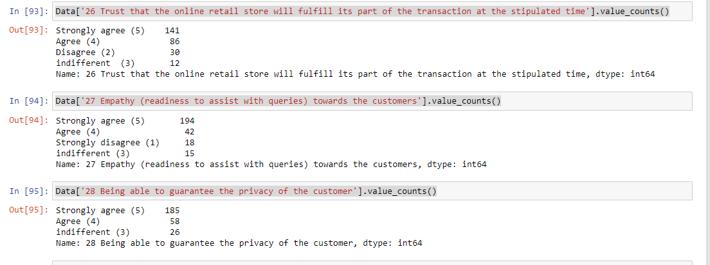
Trust, Empathy and Customer Privacy

Slide 20
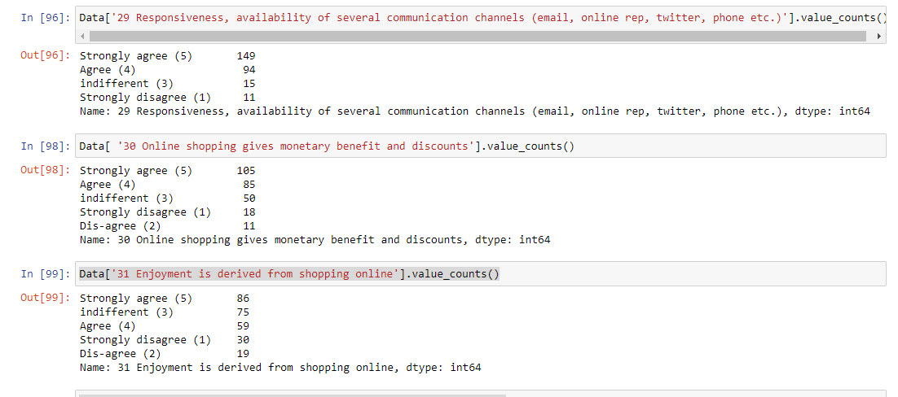
Responsiveness, Monetary Benefits and Enjoyment

Slide 21
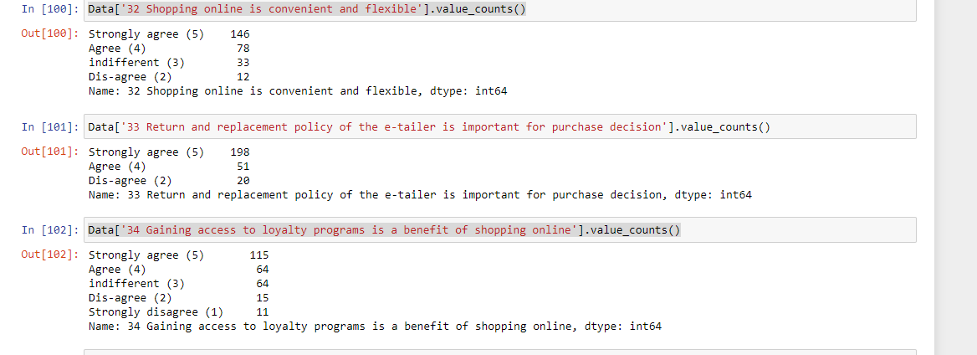
Convinient and Flexible/Return and Replacement Policy/Access to Loyalty Programs

Slide 22
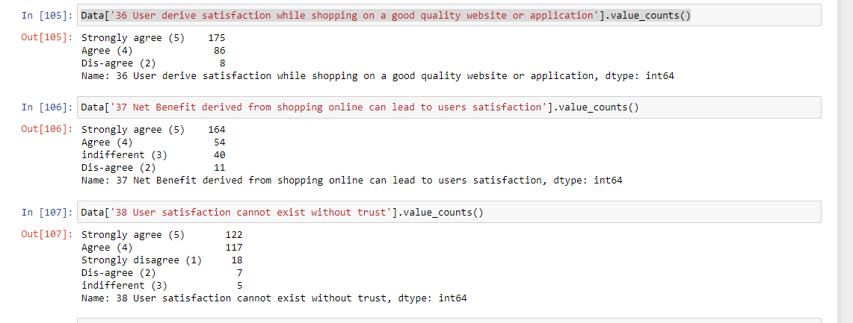
Deriving Satisfaction

Slide 23
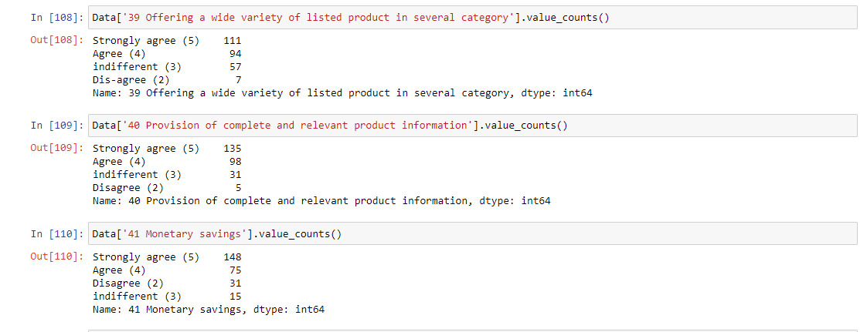
Wide Product Variety/Complete product Information/Monetory Savings

Slide 24
Opinions on Few Online Retailers
( Comparison has been made taking public’s opinion as well customers who have been retained by the online platforms)

Slide 25
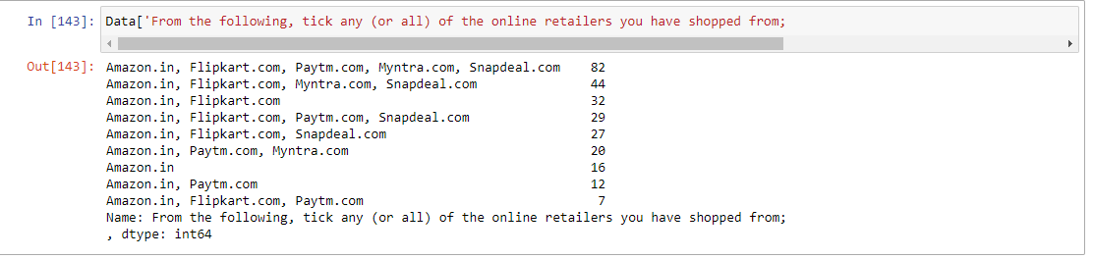
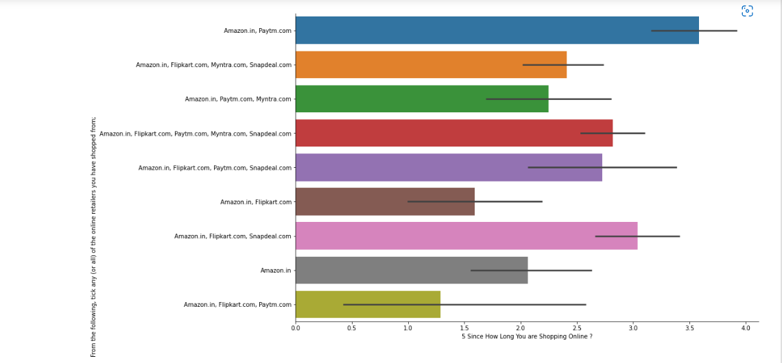
Commonly Used Online Platform

Slide 26
Observation
Amazon, Myntra, Paytm, Flipkart Snapdeal are mostly used
In the above list however Amazon in and Paytm has retained more customers

Slide 27
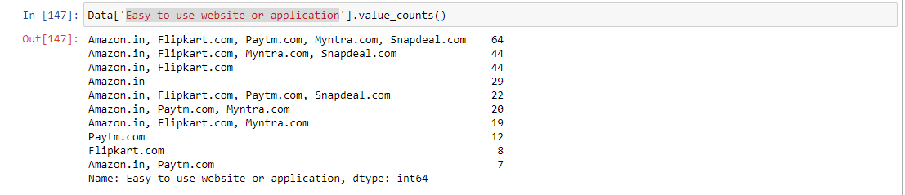
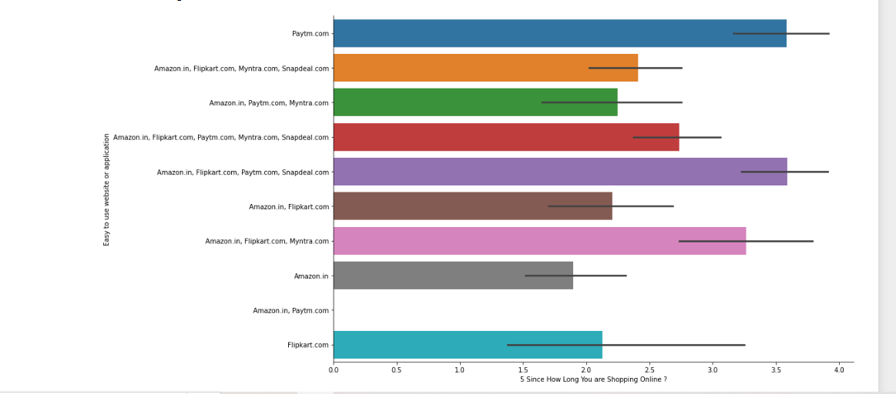
Easy to use website or application

Slide 28
Observation
Amazon, Myntra, Paytm, Flipkart Snapdeal are easiest to use and has also helped in retaining customers

Slide 29
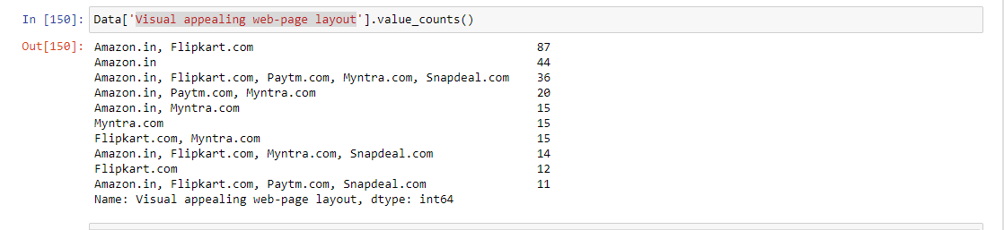
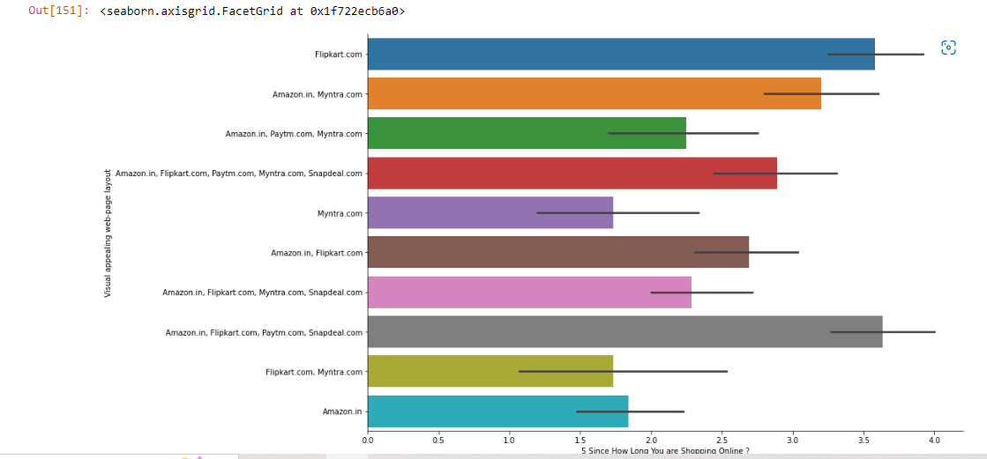
Appealing Web Layout

Slide 30
Observation
In terms of numbers Amazon and Paytm has the most appealing web layout
However customers who have been retained has also favoured Snapdeal and Paytm

Slide 31
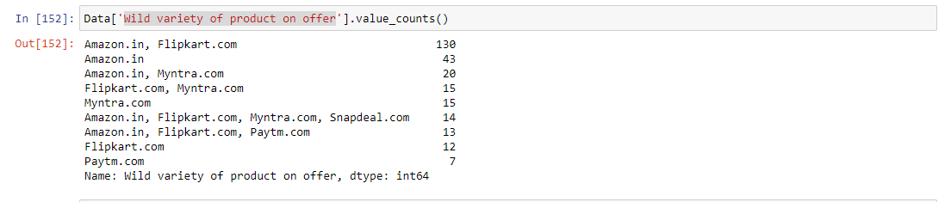
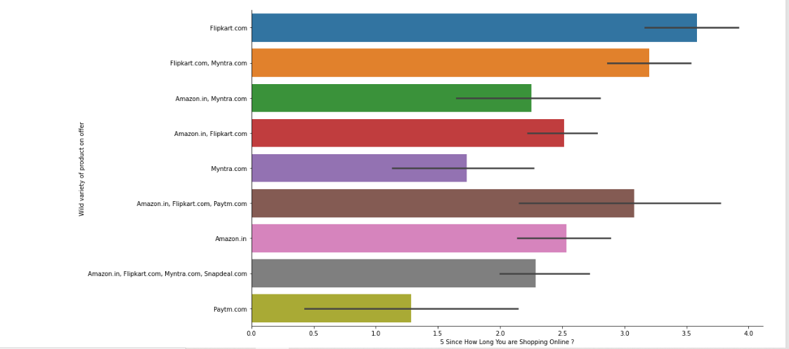
Product Variety

Slide 32
Observation
Amazon and Flipkart has more product variety
However Flipkart has retained more customers than Amazon

Slide 33
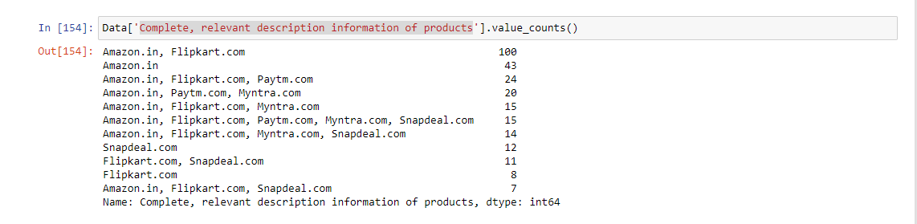
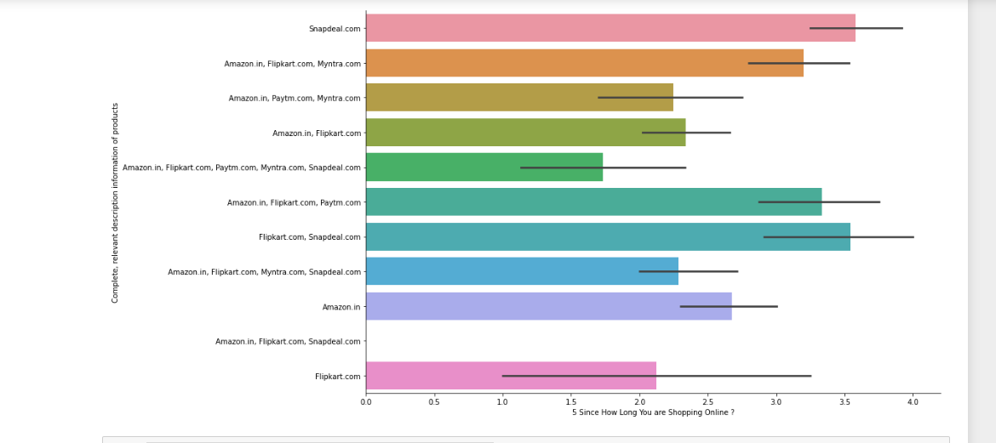
Product Description and Information

Slide 34
Observation
Amazon and Flipkart has been more reliable in product description
However customers who have been retained for a longer time also agrees with Snapdeal

Slide 35
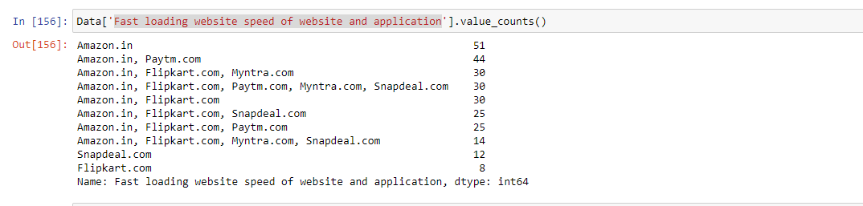
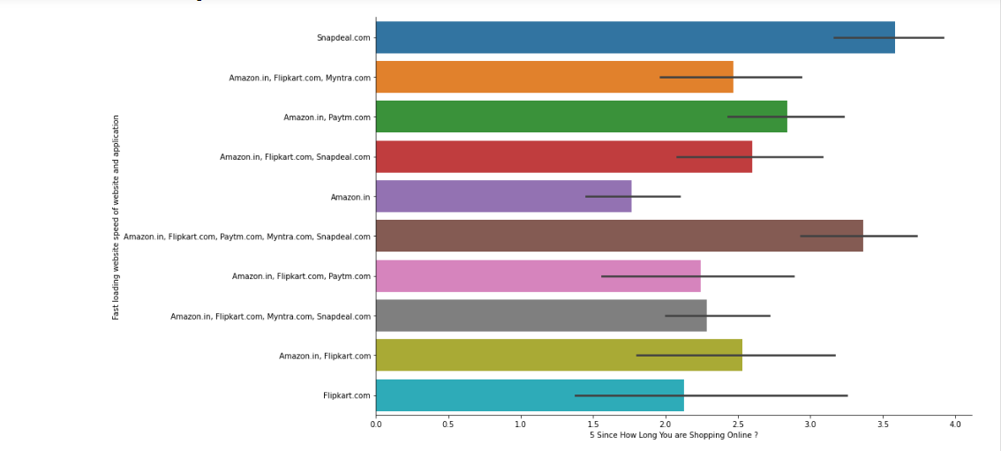
Fast Loading ( Amazon In and Snap Deal)

Slide 36
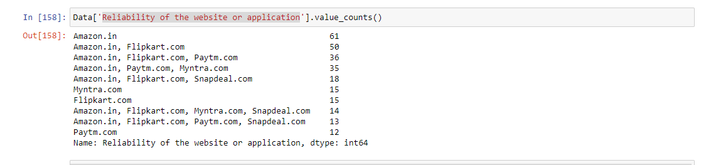
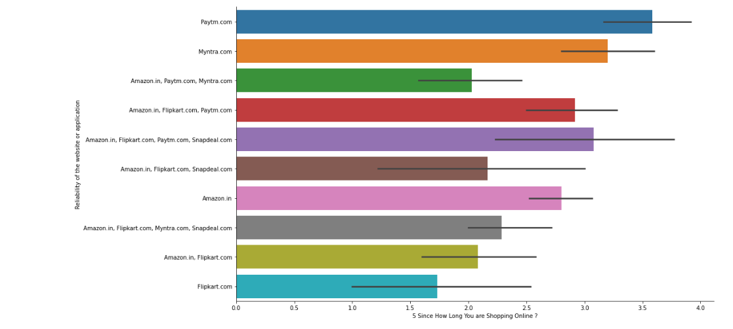
Reliability- Amazon and PayTm ( Longer Customer Retention)

Slide 37
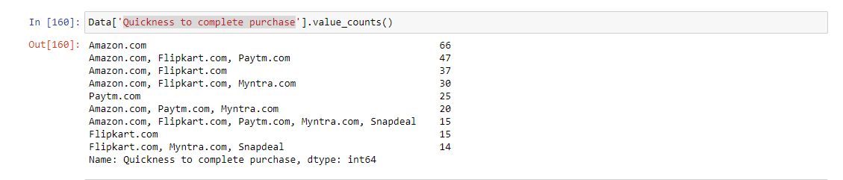
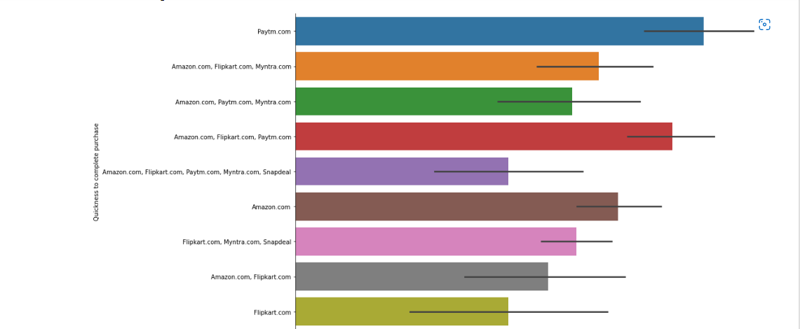
Quick Purchase- Amazon and Paytm ( Longer Customer Retention)

Slide 38
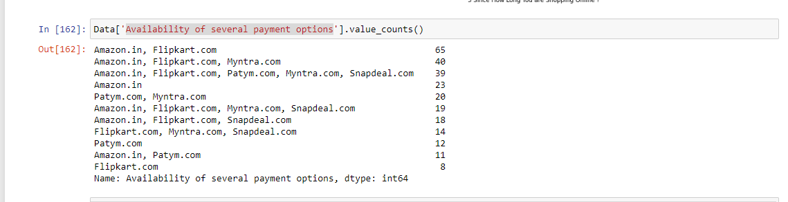
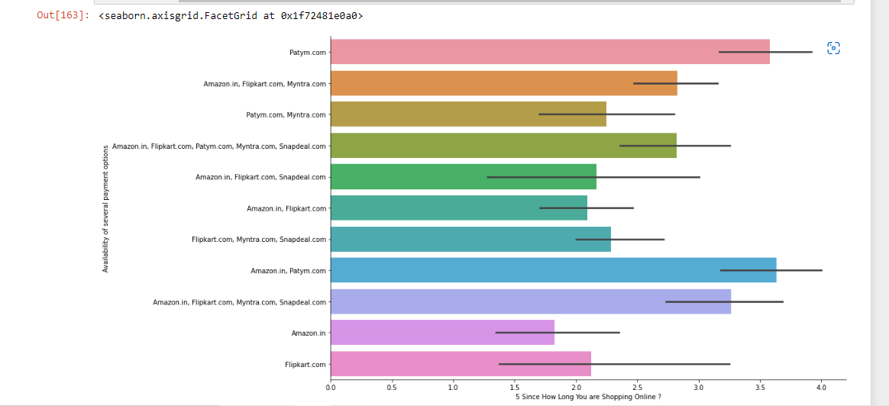
Several Product Availability- Amazon, FlipKart and PayTm ( Longer Customer Retention)

Slide 39
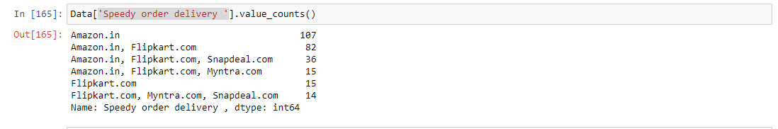
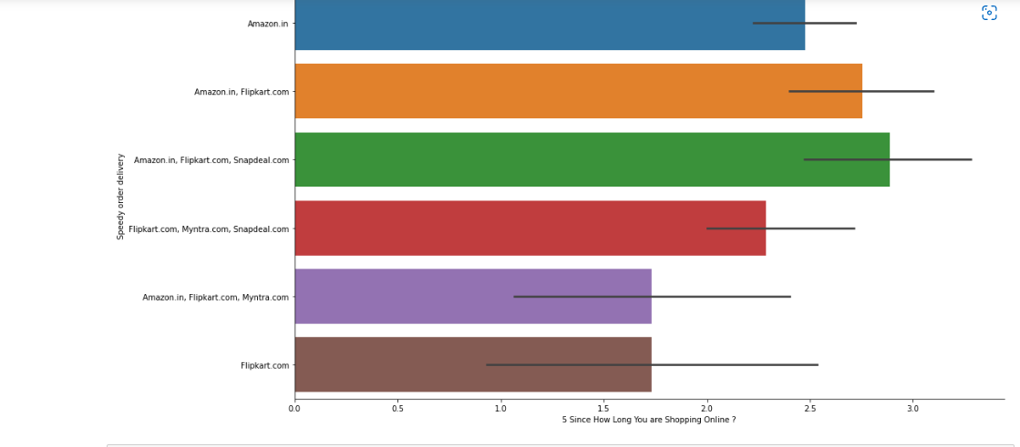
Speedy Delivery- Amazon, FlipKart and Snapdeal ( Customer Retention)

Slide 40
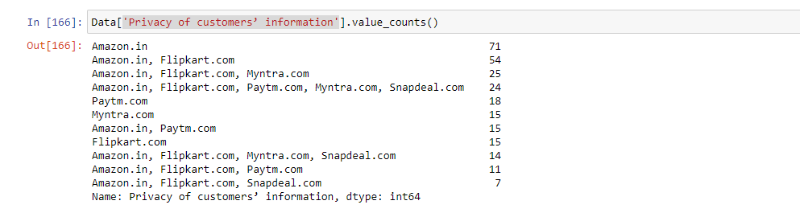
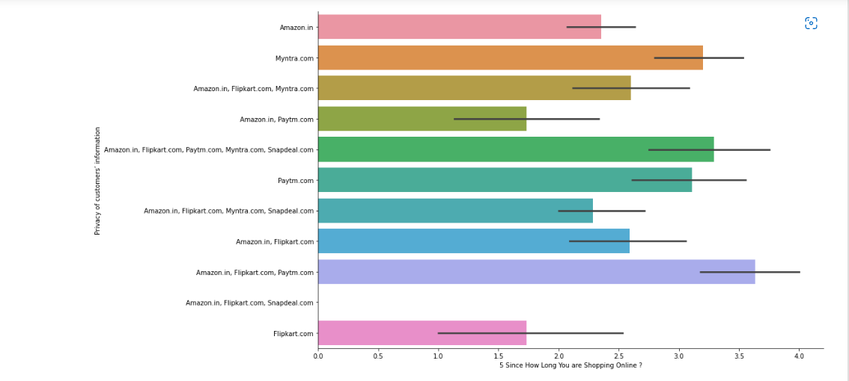
Customer Privacy- Amazon, FlipKart and PayTm ( Customer Retention)

Slide 41
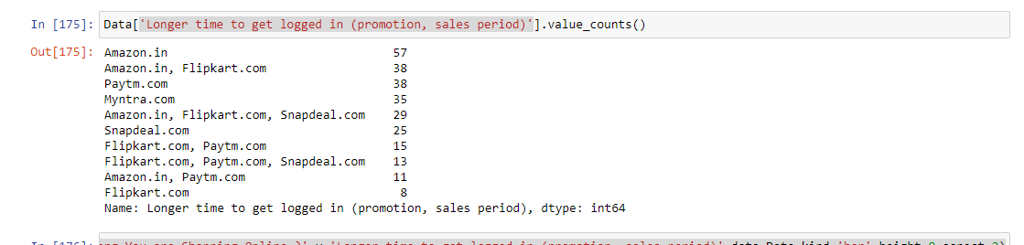
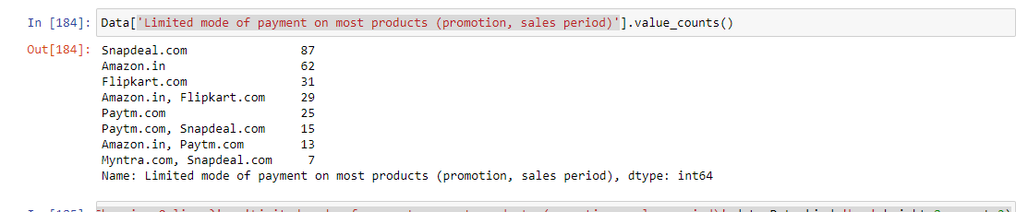
Longer Time to Log, Limited Payment

Slide 42
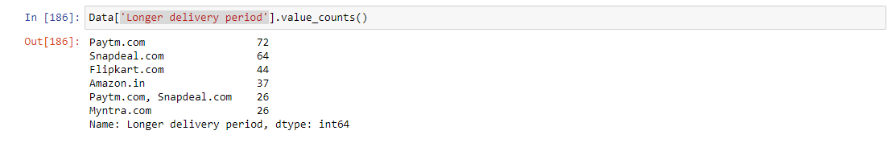
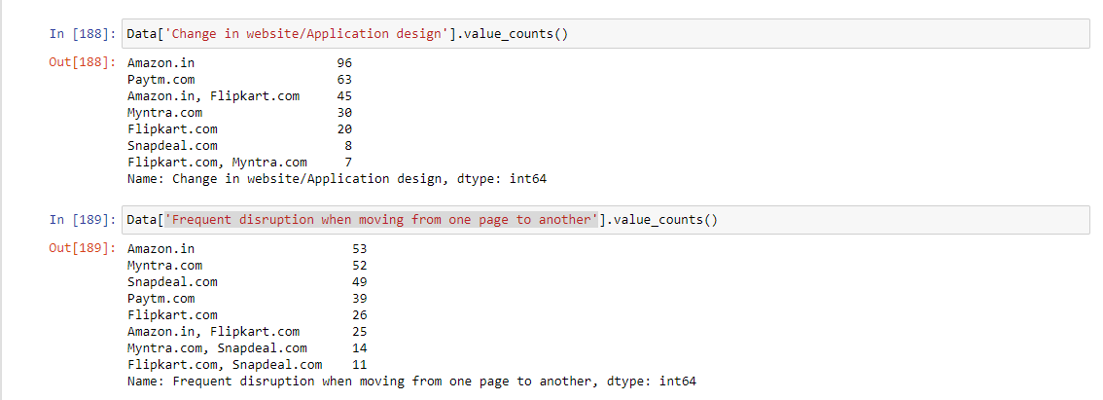
Longer Delivery, Change in website, Frequent Disruption

Slide 43


Efficient Website

Slide 44


Recommendation

Slide 45
Conclusion
In terms of various online platforms there is a slight difference in common public opinion and sites which have retained customers over 4 years. Therefore the conclusion can be divided into two parts 1. Customer Popularity 2. Customer Retention
This has been explained in next slide.

Slide 46
Customer Popularity:
Amazon has the most popularity in terms of common usage, wide variety products, reliability, fastest speed, efficiency , customer privacy, product availability and quick purchase. However it also has disadvantage in Longer time to log, payment mode issue, frequent page disruption and change in website. Due to which there is also a lot of churning.
Customer Retention:
Customer Retention over 4 years has been mainly maintained by Flipkart, Paytm and Snapdeal with fastest speed, efficiency , customer privacy, product availability and quick purchase. It also has a recommendation from customers using Online Platform for a long time and has less payment issue, logging time and a low frequent page disruption and website change.

